Slide 1
Object Oriented Analysis & Design
Ganesh Kumaar S.
2018503025
MN Batch

Slide 2
Tools Used
Star UML
Planhammer online tool for planning (https://planhammer.io/signin)

Slide 3
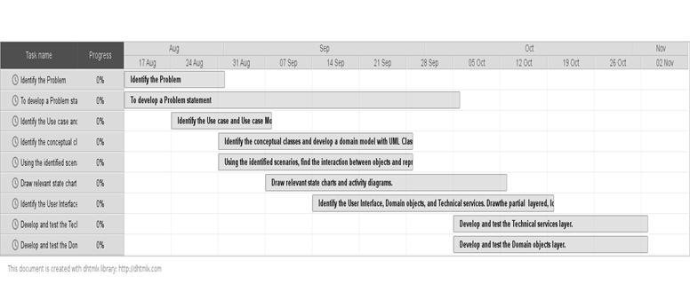
Gannt Chart

Slide 4
Problem Statement
Problem: Apartment Management System
Aim: To develop an application for managing the books of small apartment complexes.

Slide 5
Introduction
Currently smaller apartment complexes maintain their books in a ledger manually. This is not very efficient and it is tiresome to generate reports.
This system helps smaller apartment complexes manage their books efficiently by using an automated system.

Slide 6
Apartment Management System will help the Apartment Management committee to track the monthly collection of subscription fees, track the expenses and provide an accurate statement of the books.
Therefore, the apartment management system can be used to generate the statements and provide an accurate statement of the books easily and without much of delay.
The use case descriptions and other documents are described in such a way that the user understand it and finds it easy to use.

Slide 7
Objective
The purpose of this document is to define the requirements of Apartment Management System. This system contains the details about the apartments with in the complex such as area, owner, contact details, monthly subscription. It also tracks the expenses carried out in maintaining the apartment complex.

Slide 8
Scope
In the apartment management system, the clerk should enter their details of the subscriptions received for the month and any expenses incurred in maintaining the apartment complex. The manager will be able to generate MIS reports such as subscription overdue, monthly ledger, etc.

Slide 9
Detailed Problem Statement
Setup apartment details
This function will do the initial setup of the application at the apartment complex. This will include setting up users, setting up the number of apartments and their details such as apartment number, area, monthly maintenance dues, contact details.
Enter receipt of monthly maintenance dues
As residents pay the monthly maintenance dues, clerk will enter those details in the system.
Enter details of expenses incurred in running the apartment complex
This function will allow the clerk to enter the details of the expenses incurred for running the apartment complex such as staff salary, electricity dues, diesel for genset and other routine maintenance and repairs.

Slide 10
Generate report of defaulting residents of monthly maintenance dues
After the cut off date (5th of the month), the manager will be able to use this function to generate the defaulting residents who have not paid their monthly maintenance dues.
Generate monthly report of receipts and expenses
At any point, the manager would be able to generate the monthly statement for any of the previous months for review.

